Slide 1



Financial Market Anomaly Detection

Slide 2
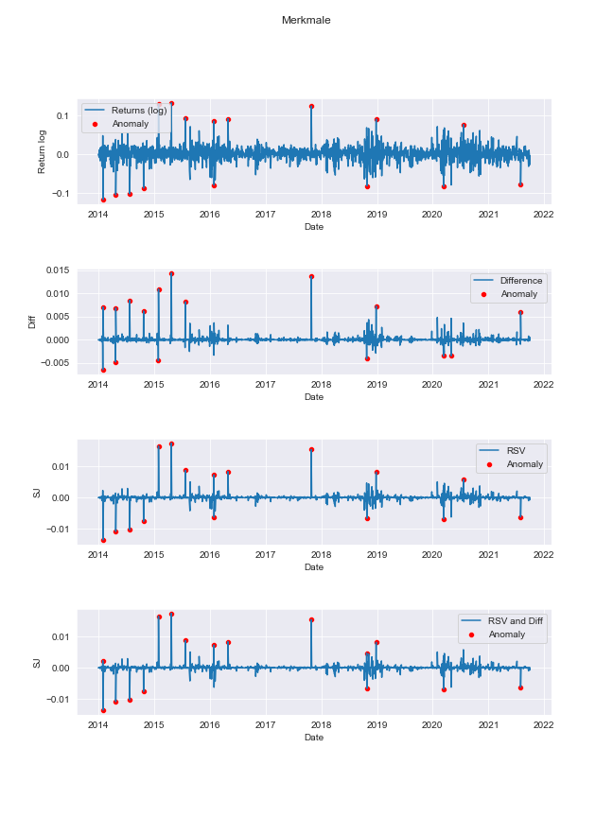
TEAM DETAILS
R Yuvaraju - 99210041906
G Siva Krishna- 99210042137
K Yaswanth kumar - 99210042194
Madhav Kumar - 99210041470

Slide 3

s
Introduction
This project aims to detect anomalies in financial time series data, utilizing the Isolation Forest algorithm and feature analysis. By simulating anomalies through a Merton jump-diffusion process and extracting key features, the study adapts concepts from a master's thesis for practical implementation. Employing Python 3.9 and Jupyter Notebooks, the project addresses the essential task of enhancing market surveillance and regulatory compliance by identifying irregular patterns that may lead to sudden price jumps.

Slide 4
Aim of the project
The aim of his work is to verify the usability of the Isolation Forest for anomaly detection in finance market data. The analysis of test data and the comparison of the results provide a verified model that is suitable for use on real data. In the financial market analysis, significant increases or decreases in the price fluctuations of both, the stock chart and the features charts, should be recognized.
.

Slide 5

Technologies
Machine Learning: Application of algorithms to detect outliers in financial data
Big Data: Utilizing large datasets for anomaly detection and pattern recognition
Python Libraries: Using pandas, numpy, scikit-learn for data preprocessing and modeling
Her we are using Isolation Forest and Features.
The Merton jump-diffusion model allows for a more realistic representation of asset price dynamics, capturing both the continuous fluctuations and the occasional large movements observed in financial markets. It is commonly used in option pricing, risk management, and other areas of quantitative finance to account for the impact of unexpected events on asset prices.

Slide 6
Data Setup
The test data will be generated with the help of a Merton jump diffusion model. This process combines a Brownian motion and Poisson distributed jumps. The features extracted include return, realized variance, realized bipower variation, difference, and signed jumps.

Slide 7
Extracted Features
Return
Realized Variance
The return feature captures the percentage change in the value of a financial asset over a specific period of time.
Realized variance measures the daily dispersion of an asset's price, reflecting its volatility over time.
Realized Bipower Variation
Difference and Signed Jumps
Realized bipower variation quantifies the quadratic variation in the asset's price process, providing insights into nonlinear dependencies.
Difference and signed jumps indicate the changes in the asset's price and the direction of the jumps, aiding in anomaly detection.

Slide 8
Literature Survey :
Authors(S) | Year | Title | Description
Feng, G., Xu, J., & Li, Y. | 2023 | Financial Anomaly Detection for Technology Companies with Deep Ensemble Learning | Proposes a deep ensemble learning framework for anomaly detection in financial data of technology companies, considering the unique characteristics of FANG companies.
Li, S., Wang, C., & Wang, J. | 2022 | A Survey on Financial Anomaly Detection for Big Data | Surveys various anomaly detection techniques applicable to big financial datasets, including those generated by FANG companies.
Srinivasan, R., & Chen, Y. | 2021 | Anomaly Detection in Financial Time Series Data of Technology Companies Using LSTMs | Applies Long Short-Term Memory (LSTM) networks for anomaly detection in financial time series data of technology companies, potentially including FANG companies.
Zhang, Y., Li, Z., & Wang, C. | 2020 | Financial Anomaly Detection for Listed Companies Based on Isolation Forest and Improved K-Nearest Neighbors | Develops a hybrid approach using Isolation Forest and improved K-Nearest Neighbors for anomaly detection in financial data of listed companies, potentially applicable to FANG companies.
Zhao, G., Wang, Y., & Xue, Y. | 2019 | Financial Ratio Anomaly Detection Based on Deep Belief Networks | Explores Deep Belief Networks for anomaly detection in financial ratios, which can be used for companies like FANG.

Slide 9
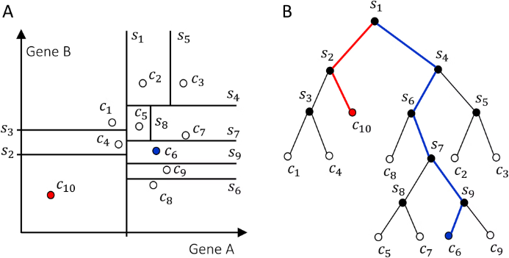
Isolation Forest and CutOff Detecting on Data
An Isolation Forest is an unsupervised learning algorithm that identifies anomalies in a dataset. It does this by isolating the anomalies in the data, which makes it suitable for detecting financial market anomalies.

Slide 10

Challenges
1
Data Quality
Ensuring accurate and consistent data for anomaly detection.
2
Algorithm Selection
Choosing the most suitable algorithm for detecting anomalies.
3
Interpreting Results
Understanding and interpreting the identified anomalies effectively.

Slide 11
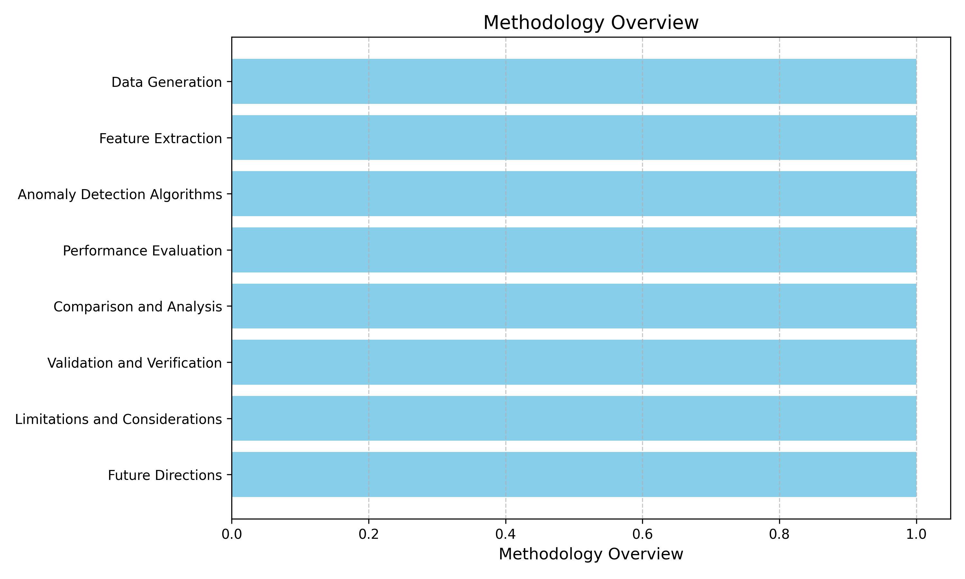
Methodology Overview :

Slide 12



Results
Insights
Visualization
The outcome of the anomaly detection process is crucial to analyze and interpret the anomalies detected in the financial market data.
Extracted anomalies can provide valuable insights into the behavior and patterns within the financial market, aiding in decision-making.
Visual representations of the anomalies discovered can aid in understanding the impact and significance of the detected anomalies.

Slide 13
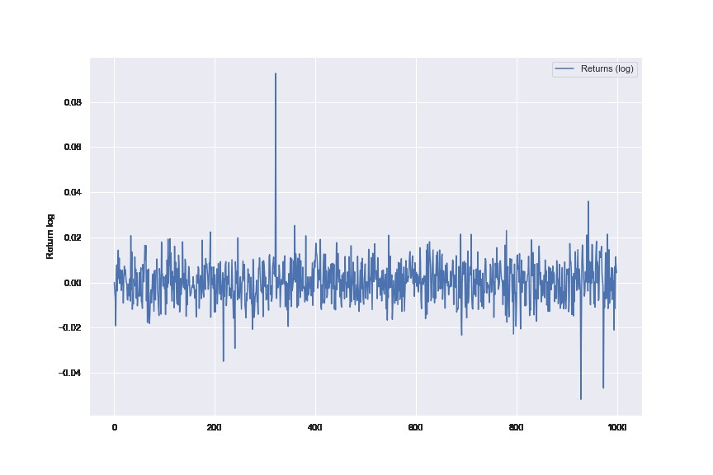
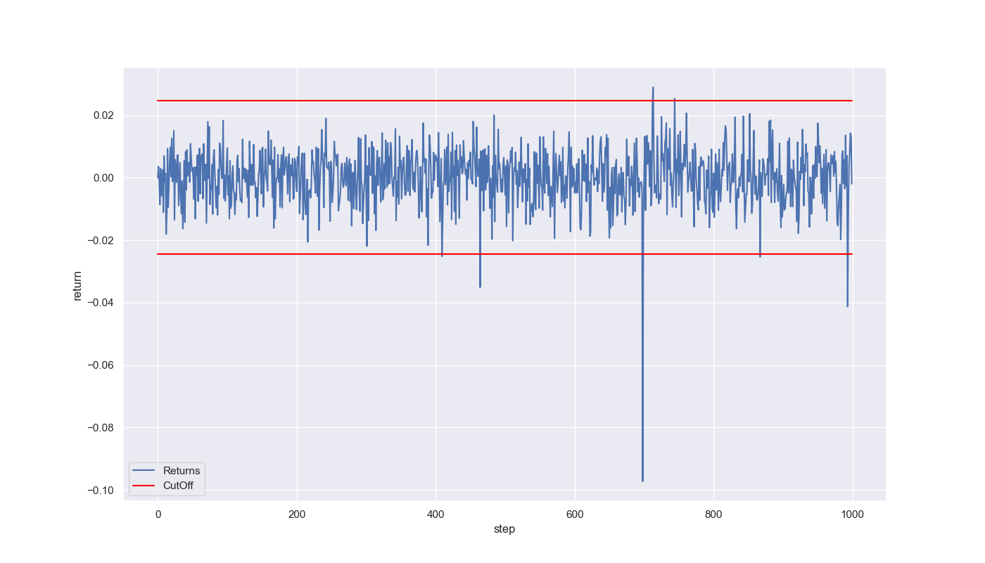
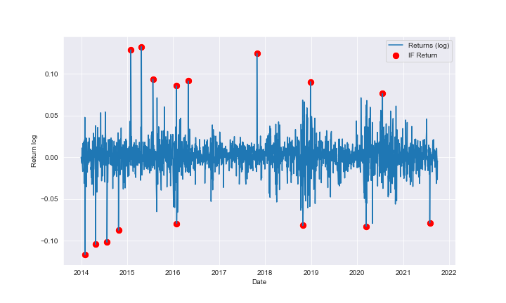
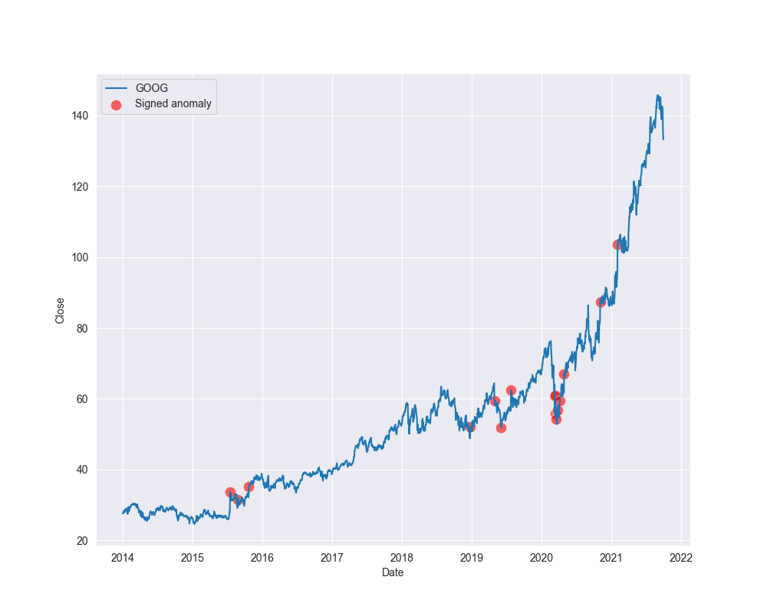
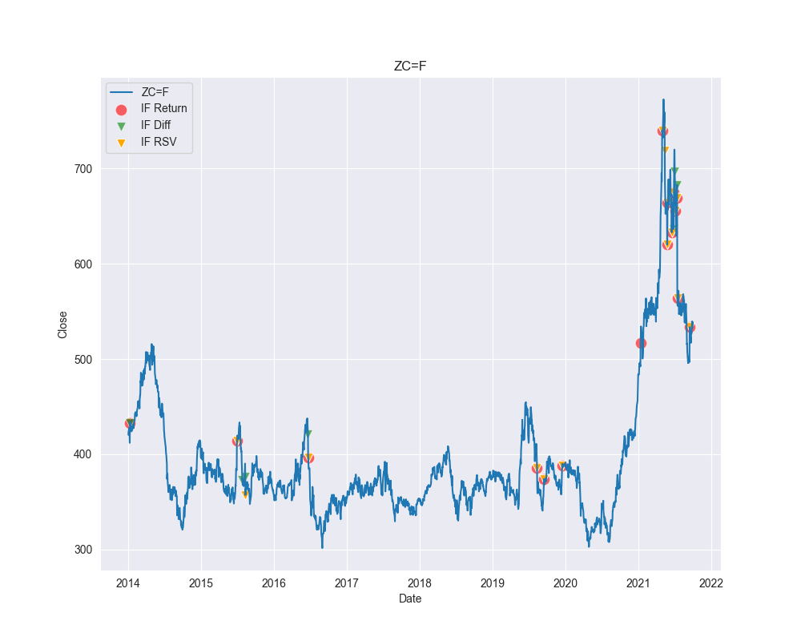
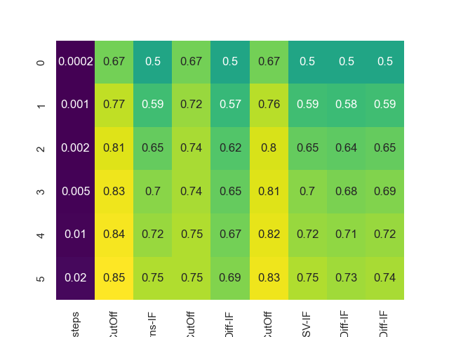
OUTPUT SAMPLE
Time series test data
Cut off test data
Return stock data
Anomaly adjustment stock data
Chart Anomalies Stock data
F1 – score of project

Slide 14

Conclusion
After implementing the Isolation Forest and CutOff Detection, the project successfully identified anomalies in the financial market data.
The combination of these technologies effectively detected unusual patterns, providing valuable insights for anomaly detection in financial markets.
This approach will contribute to better risk management and decision-making processes in financial market analysis.

Slide 15
RESULTS:-
Data Reproduction Challenges:
Artificial test data from the master’s thesis could be reproduced.
Merton-jump process dependency on parameters made it challenging to replicate time series with exact fluctuations.
Comparison of CutOff and Isolation Forest:
In the experiment, CutOff consistently outperformed Isolation Forest.
Difference in performance had no impact on further analyses due to the inability to calculate CutOff for real data.
Feature Analysis for Isolation Forest:
Isolation Forest demonstrated optimal performance with the Return feature.
Partial improvements observed with the Diff or RSV feature.
Effect of Feature Combinations:
Combination of three features yielded the worst results in both cases.
F1-Score Trends:
F1-scores in the master’s thesis fluctuated with different jump rates.
Own work's F1-scores continuously improved with increasing jump rates.
Real Data Analysis:
Distinctive points identified in feature charts when analyzing real data.
Indicates Isolation Forest's similarity to the master thesis and successful experiment execution.

Slide 16

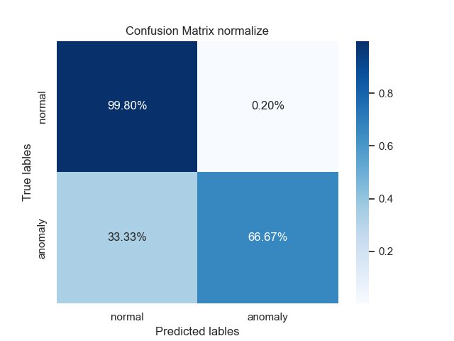
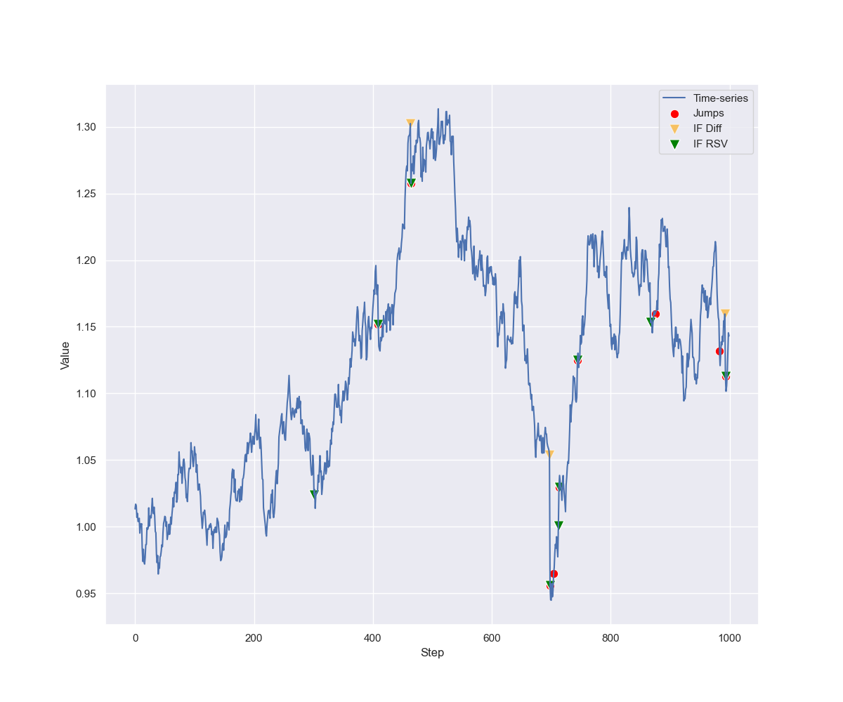
REFERENCES
Autenrieth, E., Zimmermann, P. (2021). "Anomaly Detection in Financial Market Data using Isolation Forest and Features." Unpublished project report.
2. Paulin, C. (Year). "Detecting anomalies in data streams driven by a jump-diffusion process." [Include additional details if available, e.g., university, thesis type, etc.]
Python Software Foundation. (2021). Python 3.9 Documentation. [Online] Available at: https://docs.python.org/3.9/index.html
4. McKinney, W. (2017). "Python for Data Analysis." O'Reilly Media.
Pedregosa, F., et al. (2011). "Scikit-learn: Machine Learning in Python." Journal of Machine Learning Research, 12, 2825-2830.
“Jupyter Notebook Documentation." [Online] Available at: https://jupyter-notebook.readthedocs.io/en/stable/.

